Slide 1
Prediction Of Diabetes Using Data Mining Techniques
CS6220 Data Mining Techniques - Final Project
Team Members: Paul Cruz, Chih-Ming Sun, Haocheng Yang

Slide 2
Introduction
Diabetes is a well-known disease affecting individuals all over the world. According to the WHO (World Health Association), an estimated 422 million people worldwide currently have diabetes with the majority living in low-and middle-income countries. In addition, 1.6 million deaths are directly attributed to diabetes each year.
Can diabetes be prevented?

Slide 3
Introduction
Though there are many factors that may contribute to a diabetes diagnosis, such as heredity, weight, and height, the major factor is blood sugar concentration. ​The early identification of abnormal glucose levels may be the only remedy to further complications and therefore a more serious diagnosis. ​Thus, analysis of the levels of sugar in the blood and how it may compare to other compounds measured is paramount in predictive modeling.​

Slide 4
Methodology - Dataset
The dataset used for this study was provided by Kaggle, a data repository website. This dataset was provided to the repository courtesy of the University of California, Irvine (UCI), and included 70 sets of data recorded on diabetes patients ranging from several weeks to several months’ worth of glucose, insulin, and lifestyle data per patient, as well as a description of the problem domain.
The dataset included the following tables: Pregnancies, Glucose, Blood Pressure, Skin Thickness, Insulin, BMI, Diabetes Pedigree Function, Age, and Outcome.

Slide 5
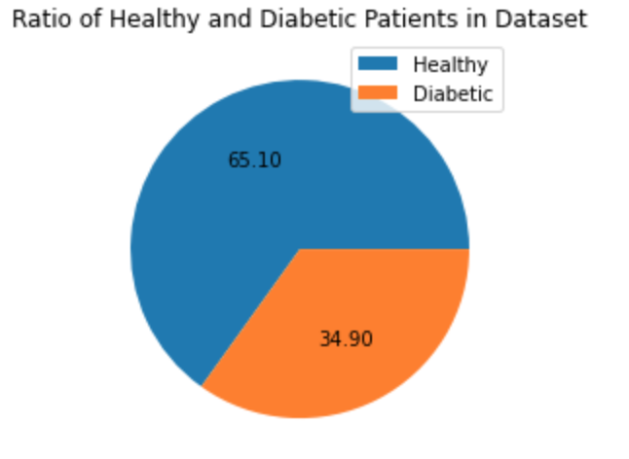
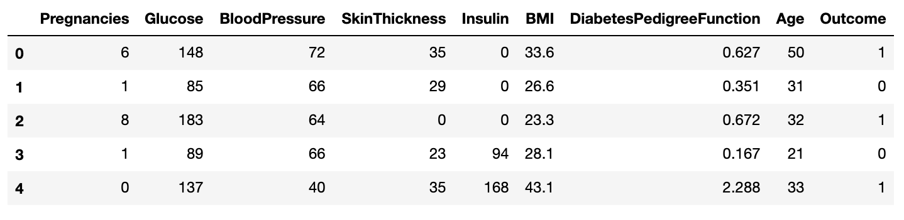
Methodology - Data Processing
Some basic analysis of the dataset

Slide 6
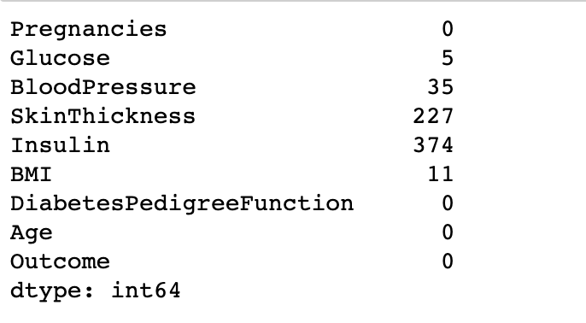
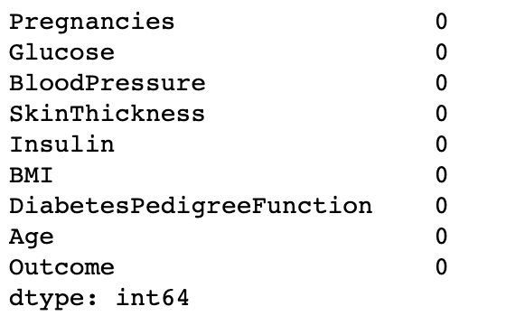
Methodology - Data Processing
The data was first viewed to allow for proper analysis of its standard distribution. The data was then pre-processed to correct data inconsistencies, missing values, and to remove null values.
Original data
After process null value
Notes:
first we replace the value of fields whose value is zero to NaN, then according the histogram we choose to fill na with mean value or median value.

Slide 7
Methodology - Data Analysis
We first created a heatmap to understand the correlation coefficient of the features of the data.
Next, we chose to plot a histogram to analyze the association between outcome and diagnosis.
We then chose to evaluate the following models by splitting the data into 70% training, and 30% test: Decision Tree, Support Vector Machine, K Neighbors Classifier, Gradient Boosting Classifier, Random Forest Classifier, Ada Boost, Gaussian NB, and Linear Regression.
Three models were chosen to move forward with the analysis, in which a confusion matrix and ROC curve was plotted and analyzed.
After analyzing feature importance and accuracy scores, two features were found to have significance.

Slide 8
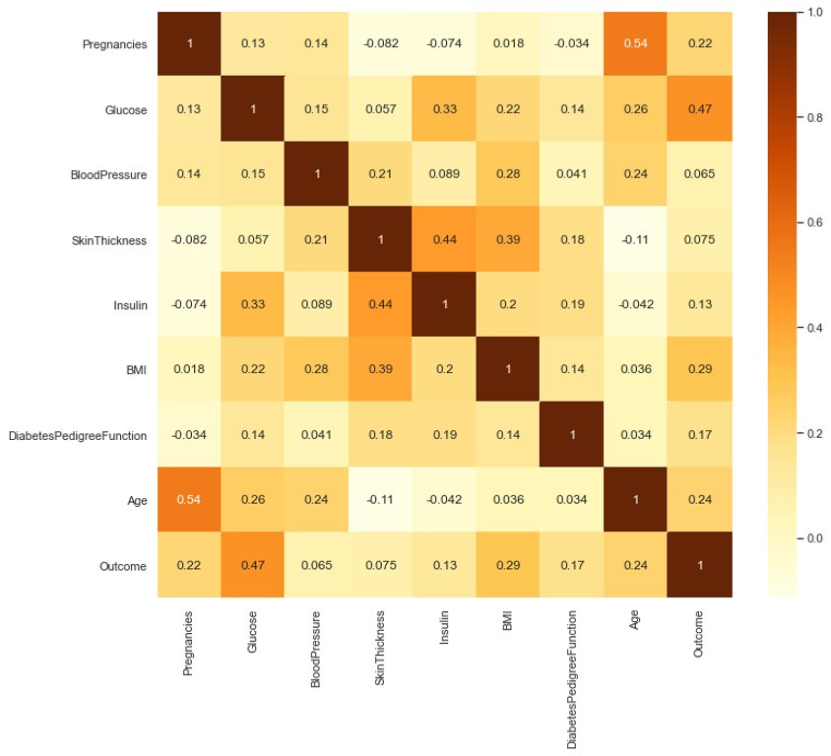
Result - Heatmap
The heatmap helps us to understand the correlation coefficient of the features of the dataset.
Intuitively form the heatmap, the darker the color is, the more correlated the two features are.
From the heatmap, we can clearly see that Glucose, BMI, Age and Pregnancies are four of the most correlated feature to lead to Diabetes.

Slide 9
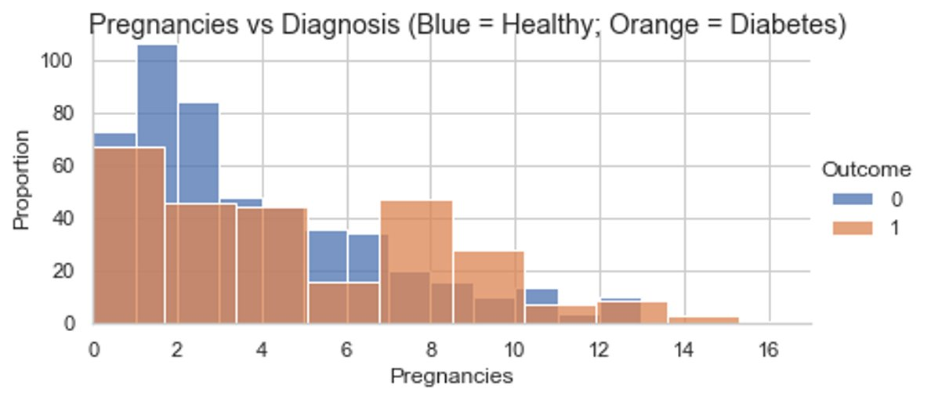
Result - Histogram (Pregnancies)
Pregnancies vs diagnosis showed that an around half of Pregnancies resulted in an outcome of a women getting diabetes.

Slide 10
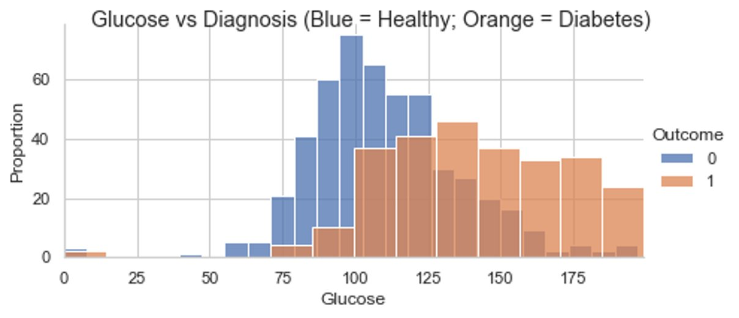
Result - Histogram (Glucose)
Glucose vs diagnosis showed that glucose levels over 76 and mainly above 125 was correlated with diabetes diagnosis.

Slide 11
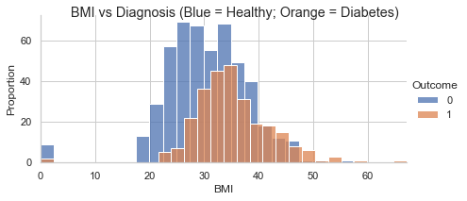
Result - Histogram (BMI)
BMI vs diagnosis showed that both healthy and diabetic individuals have two similar bell shape histograms with an obvious shift of mean.

Slide 12
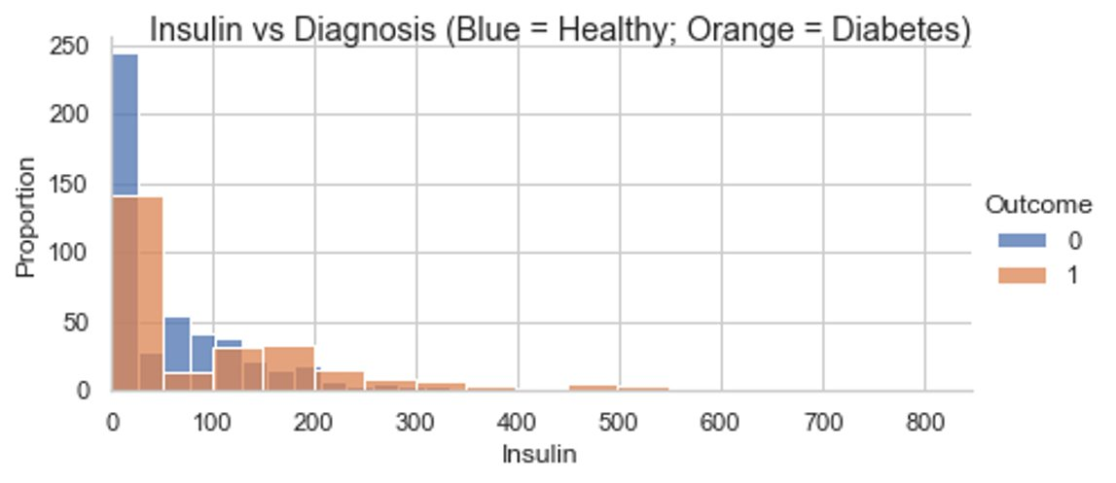
Result - Histogram (Insulin)
Insulin vs diagnosis found the same, that health and diabetic patients exhibited similar insulin levels.

Slide 13
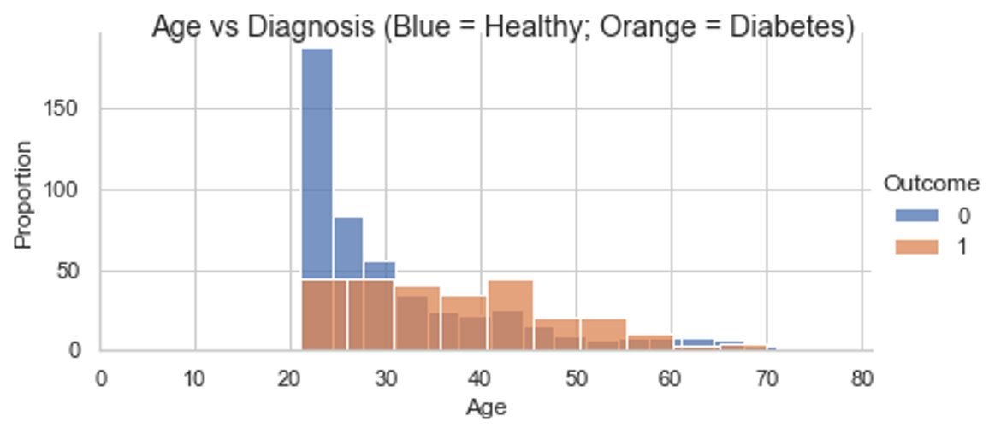
Result - Histogram (Age)
Age vs diagnosis showed that diabetes in this dataset is found between the ages of 22-70 years old, and people around 40-50 has a high potential to get diabetes.

Slide 14
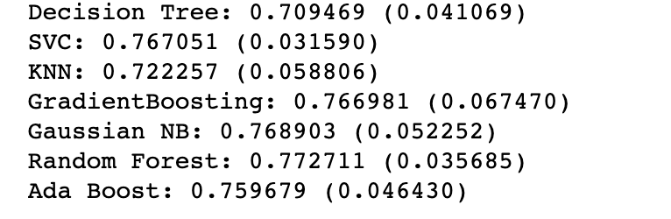
Result - Modelling
Initially, we build 7 classifying models, and analyzed their prediction accuracy.
They are:
Decision Tree
Support Vector Machine
K Neighbors Classifier
Gradient Boosting Classifier
Random Forest Classifier
Ada Boost
Gaussian NB

Slide 15
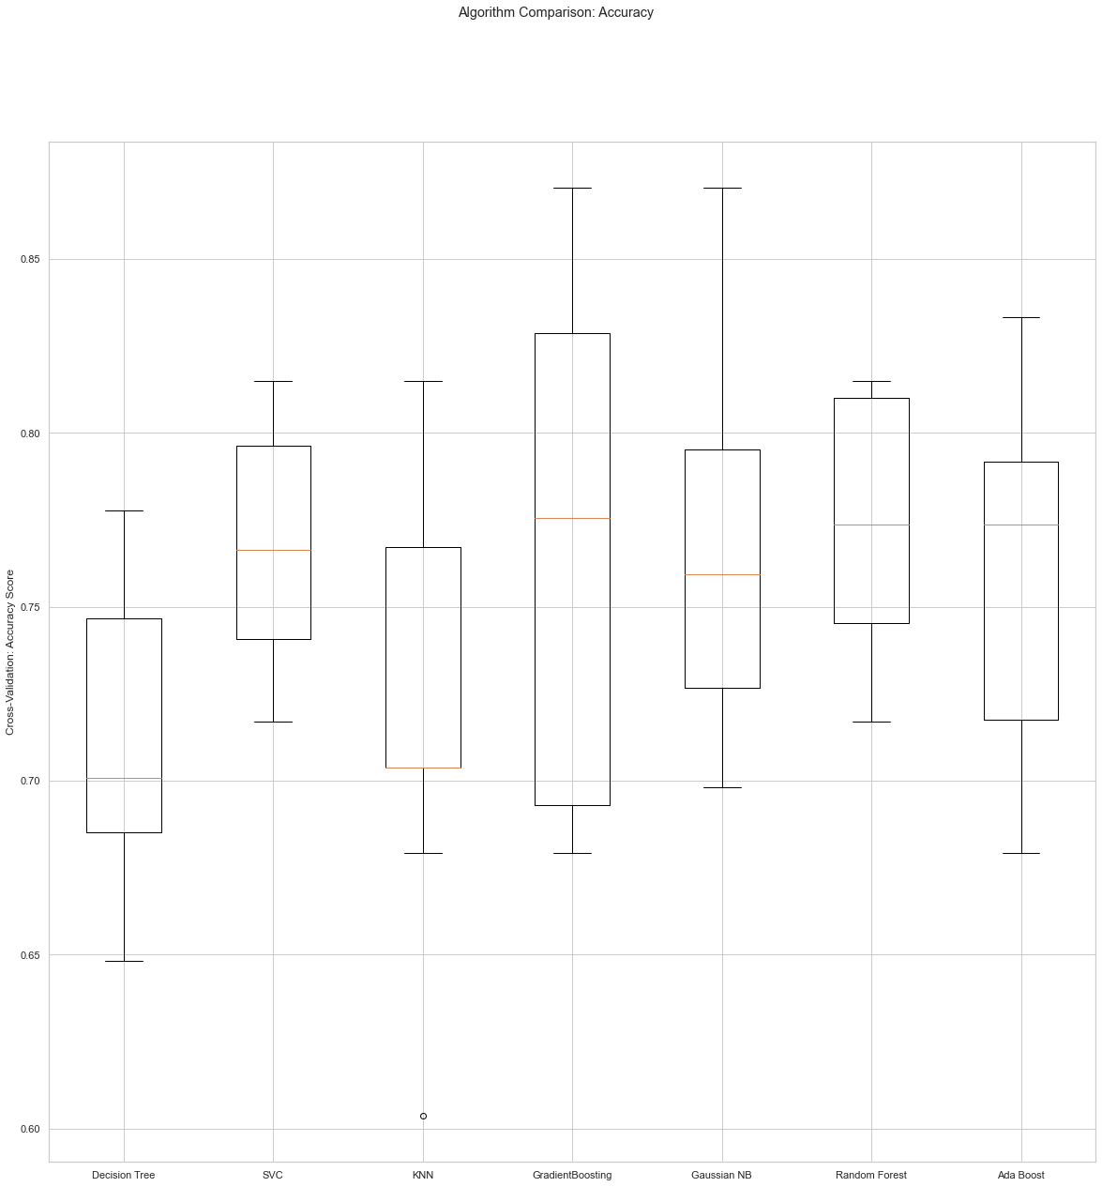
Result - Modelling
Then we compared the accuracy of each model by drawing the boxplot.

Slide 16
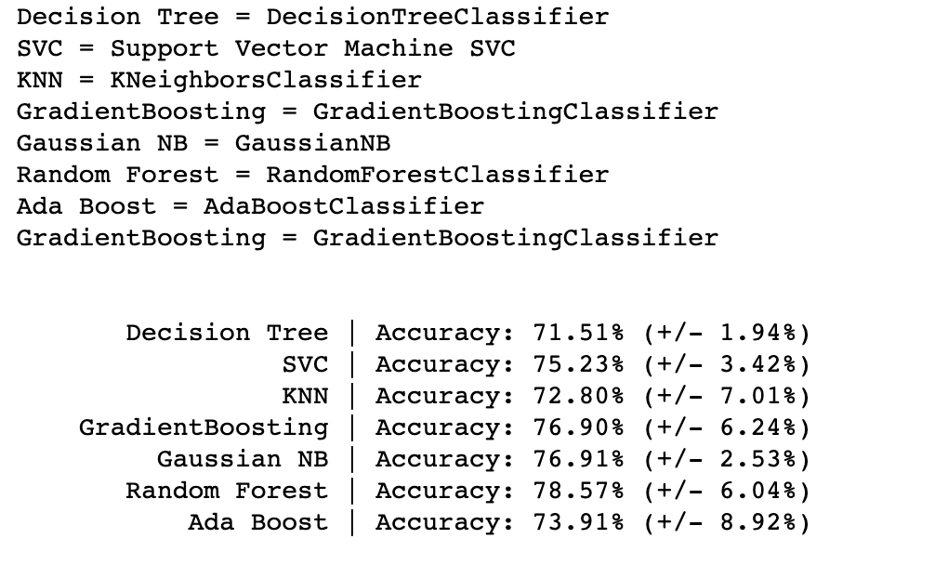
Result - Modelling
Again, We changed the iteration time and used cross validation score to see the accuracy of each classifier.
After comparing and analyzing, we chose 3 models to explore their capability of predicting diabetes. ​
They are: RandomForest, GradientBoosting, and Ada Boost

Slide 17
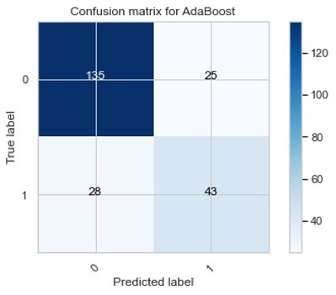
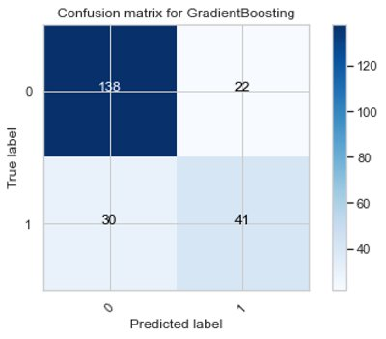
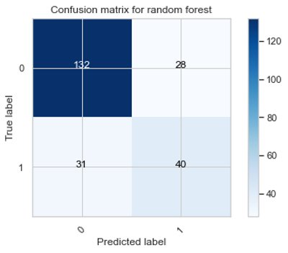
Result - Confusion Matrix

Slide 18
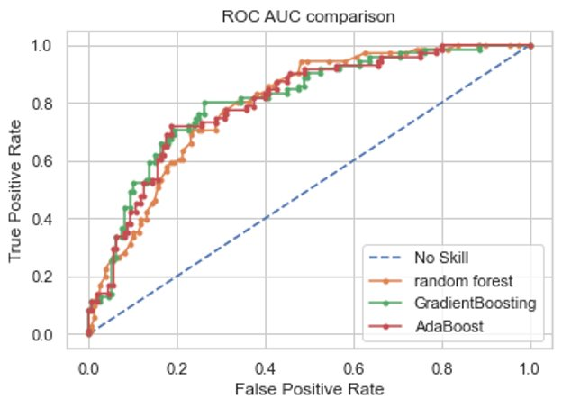
Result - ROC
ROC AUC comparison was plotted with Baseline, Random Forest, Gradient Boosting, and Ada Boost. The result of the plot shows that all three models are very good prediction model, while the Gradient Boosting is the best predictive model.

Slide 19
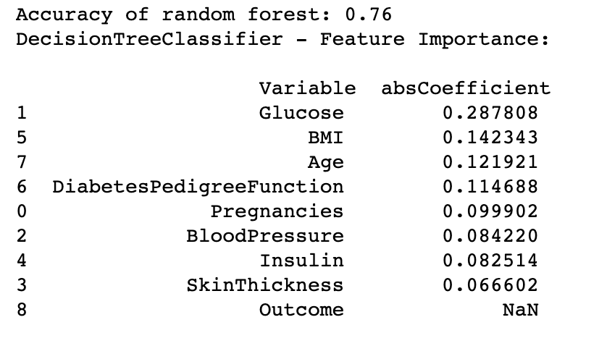
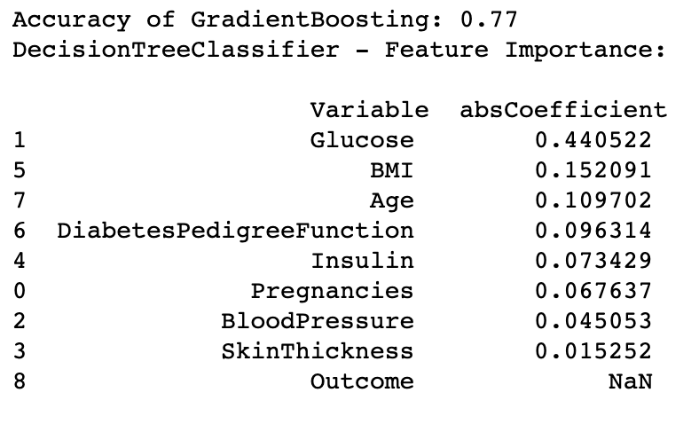
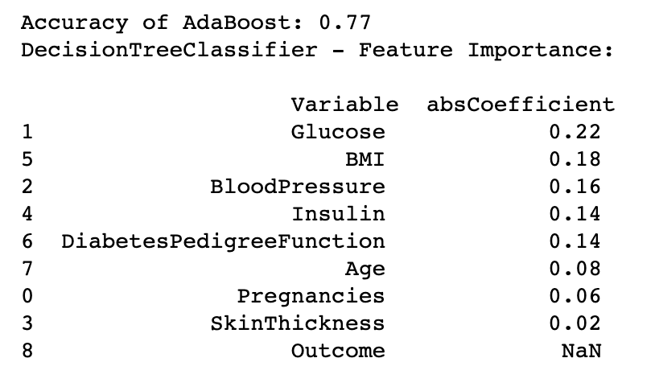
Result - Accuracy & Feature Importance
Again, we calculated the accuracy of the three models as well as the importance of each features, and the result is below.

Slide 20
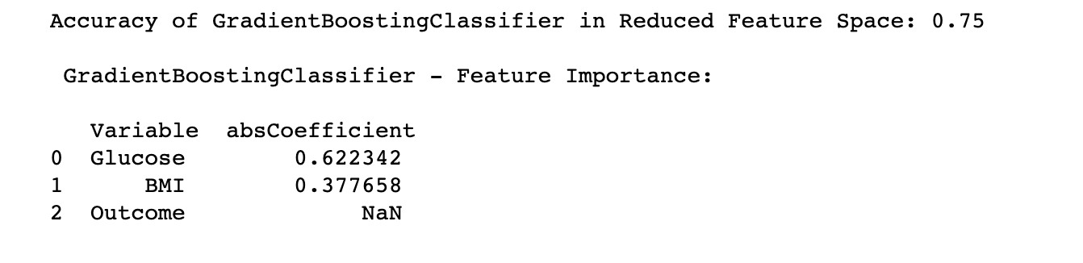
Result - Reduce features
Two features were found to have the most importance; Glucose and BMI.
We dropped columns and only kept the two columns Glucose and BMI. And we repeated the steps to use Gradient Boosting Classifier, and the final accuracy is 75%, with Glucose absolute coefficient being 0.62, and BMI 0.37.​

Slide 21
Discussion
The model evaluated in this study shows how data mining techniques via machine learning predictive modelling can be used to predict human disease. ​
Our results show how machine learning and classification algorithms can be used to predict diabetes.
The two features that were found to be most important were BMI and glucose.

Slide 22
Discussion
For BMI, there is a certain relationship between the satisfaction rate of blood glucose control and overweight or obesity, which explains the importance of BMI in the classification of control satisfaction.​
This tells us that lifestyle choices can make a difference between whether you develop diabetes or not.

Slide 23
Discussion
The results show that there are many predictive models that can be applied, but only certain models will work best which is very dependent on the selected dataset. ​
Therefore, when focusing on a certain disease, several appropriate classification algorithms should be selected based on the characteristics of the dataset. ​
By comparing the classification accuracy of many classification algorithms on the dataset, the most effective classification algorithm can be selected and used as the diagnostic model.

Slide 24
Discussion
In general, the performance of machine learning algorithms is evaluated using predictive accuracy. ​
In addition, despite the claims that machine learning classification algorithms can generate sufficient and effective decision-making, very few have really permeated the clinical practice. ​
Therefore, the practice of using machine learning algorithms to predict disease should be under further study in the biomedical research and development field, and we hope that this study provided a good example of how this can be done.​

Slide 25
Discussion
One of the most important real-world medical problems is the detection of diabetes at its early stage. ​
In this study, systematic efforts are made in finding a system which results in the prediction of diabetes through data science via predictive modelling algorithms.​
Though this work may not be the final solution to the prediction of diabetes, it serves as an example of the power data science may have on the prediction of other diseases as well.

Slide 26
Discussion
During this work, three machine learning classification algorithms are chosen and evaluated on various measures. ​
The results determine the adequacy of the system with an achieved accuracy of 79% using the Random Forest classification algorithm. ​
In the future, this system with the use of machine learning classification algorithms may be able to be used to predict or diagnose other diseases as well. The work therefor be extended and improved for the automation of diabetes analysis using the methods described here as well as other machine learning algorithms.

Slide 27
References
Huang, R. (2021). Prediction of Pima Indians Diabetes with Machine Learning Algorithms. UCLA. ProQuest ID: Huang_ucla_0031N_19508. Merritt ID: ark:/13030/m5md4q60. Retrieved from https://escholarship.org/uc/item/6rh07945​
Altıntaş, Ergin. “UCI Diabetes Data Set.” Kaggle, 1 May 2020, www.kaggle.com/ealtintas/uci-machine-learning-repository-diabetes-data-set.​
World Health Organization (WHO). “Diabetes.” Kaggle, 2 April 2021, https://www.who.int/health-topics/diabetes#tab=tab_1.

Slide 28
Contribution
Paul Cruz:
Chih-Ming Sun:
Haocheng Yang:

Slide 29
Thank you!

